Slide 1
Simple CNN Image Classifier
Project Title
Student Name
Project No.:
Name: | ID.
Hajar Kamel Mohamed | 2025-icail-1217
Nashwa Mohamed Ahmed | 2025-icail-1265
Maysara Ahmed Abdelhameed | 2025-icail-1363
Hany Salad Aldiamoni | 2025-icail-1321
Albaker Ahmed Mohammed | 2025-icail-1243

Slide 2
Introduction
This project aims to develop a simple Convolutional Neural Network (CNN) model for image classification. CNNs are highly effective for tasks involving image recognition, making this project useful for applications such as object detection, facial recognition, and medical image analysis. The classifier will be trained to categorize images into predefined classes, providing a foundational tool for more complex image processing tasks.

Slide 3
Objectives
The main goal of this project is to create a functional CNN model capable of accurately classifying images into specific categories. The model will be trained on a dataset of labeled images, and its performance will be evaluated based on accuracy and efficiency.

Slide 4
Target Users
Students learning about machine learning and image processing.
Researchers needing a basic image classification tool for prototyping.
Developers looking to integrate simple image recognition into their applications.

Slide 5

Key Features
Image Preprocessing: Resizing, normalization, and augmentation of input images.
CNN Architecture: Implementation of convolutional, pooling, and fully connected layers.
Training and Evaluation: Model training with a labeled dataset and performance evaluation using metrics like accuracy and loss.
User Interface (Optional): A simple interface to upload images and view classification results.

Slide 6
Tools and Technologies
Programming Language: Python
Frameworks/Libraries: TensorFlow , Keras , Open CV , Numpy , Matplotlib
Development Environment: GitHub and Google Colab

Slide 7
Demo / Screenshots
• Show your AI Project in action
• Add images or describe the demo

Slide 8
Testing and Results
• How did you test your software?
• Were there any bugs or fixes?

Slide 9
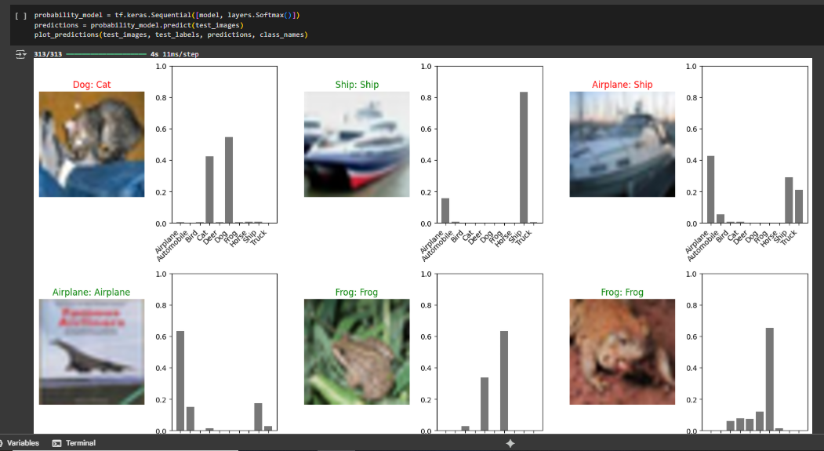

Slide 10
Final Output / Outcome
A working CNN model capable of classifying images, along with documentation and a demo (if time permits). The deliverables will include the trained model, source code, and a report detailing the methodology and results.

Slide 11
Conclusion and Future Work
• What was achieved?
Developed a functional CNN model capable of accurately classifying images into predefined categories.
Implemented key features such as image preprocessing (resizing, normalization, augmentation) and a structured CNN architectureTrained and evaluated the model using metrics like accuracy and loss, ensuring reliable performance.Delivered a foundational tool for image classification, which can be extended for more complex applications
• Any planned improvements?
Expand Dataset: Incorporate more diverse and larger datasets to improve model generalization.Enhance Architecture: Experiment with advanced CNN architectures to boost accuracy.Optimize Performance: Fine-tune hyperparameters and explore techniques like transfer learning for faster training.User Interface: Develop a user-friendly interface for seamless image uploads and real-time classification.Deployment: Deploy the model as an API or integrate it into practical applications

Slide 12

Q&A
Thank you!
Any questions?

